Slide 1
Ruby + RoR intro
Gappers

Slide 2
Intro
Ruby – interpretovaný, objektový, skriptovací, highLVL
2.1.3
prehľadná syntax, dynamické typy, cool built in veci (5.times {do smth},string.reverse)
Oproti kompilovaným jazykom pomalý
Ruby on rails
4.1.6
Rýchly vývoj, TDD, existujúce konvencie

Slide 3
Ruby
irb > puts “Hello World!”
> 2**999999
> string.reverse
> [1, 2, 3].map { |n| n * n }
#comment

Slide 4
Ruby variables
x local variable
$x global variable
@x object variables
@@x class variable
class Sample
def function
end
end

Slide 5
Naming Conventions
this_is_variable, this_is_method, this_is_file.txt
ThisIsClass, ThisIsModule::ClassInsideModule
THIS_IS_CONSTANT

Slide 6
Style guide
Limit riadku = 80 znakov
;
Item.nil? / item.empty? / item.blank?
If – unless , if !Boolean_value
‘Hello world’, “Hello #{user.name}”, “Hello world”
var == nil, var.nil?, .zero?, .odd?
One, two = 1 , 2
[0]… .first, .last
1_+_2_=_3 , 1..10, [1, 2, 3].action

Slide 7
Style guide
def method_without_args()
return result
end
def method_w_args(first, second)
1 > 2
end
For, then [1, 2, 3].each { |num| puts num }
Ternarny operator ?:, && ||, and or not, !
do_something if some_condition #one liner
Unless expecting_false if !false
var +=1 , *=3 …

Slide 8
Ruby on Rails
Opinionated
convention over configuration
DRY
REST architektúra
Give every “thing” an ID
Link things together
Use standard methods
Resources with multiple representations
Communicate statelessly (stateless variables ;) )

Slide 9
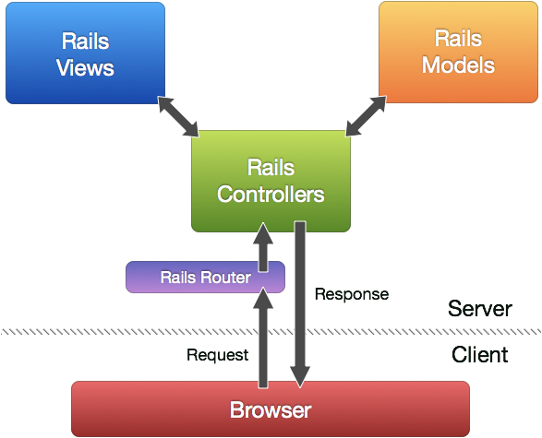
MVC

Slide 10
MVC for dummies
MODEL = zaznam v db
VIEW = html subor obohateny o ruby syntax
.erb, .haml == to čo vidíte v prehliadači
CONTROLLER = spracuje requesty z prehliadaca a vrati data pre prisluchajuci view, ktory sa zobrazi v prehliadaci

Slide 11
App parts
Action Pack
Action Controller
Action Dispatch
Action View
Action Mailer
Active Model
Active Record
Active Resource
Active Support
Railties

Slide 12
WTF?
Migration
Gem
Asset pipeline

Slide 13
App structure
Gemfile gemy nasej appky
app/ tu sa nachadza MVC, assets (js,css)
config/ konfiguraca - cesty v aplikacii, db atd
db/ db schema a migracie
lib/ rozsirenia
log/ logy
public/ folder pristupny cez web
test/ testy
tmp/ temp files
vendor/ zdrojaky tretich stran

Slide 14
Ruby 2.1.3 Setup - RVM
sudo apt-get update
sudo apt-get install curl
\curl -sSL https://get.rvm.io | bash
source ~/.rvm/scripts/rvm
rvm requirements
rvm install 2.1.3
rvm use 2.1.3 –default
ruby -v

Slide 15
Git setup
Pridajte si váš private ssh key na github
git config --global color.ui true
git config --global user.name "YOUR NAME”
git config --global user.email "YOUR@EMAIL.com"

Slide 16
RoR 4.1.6 Setup
#sudo apt-get install nodejs [javascript runtime]
gem install rails
rails –v
Rails –s

Slide 17
PostgreSQL 9.3.5
sudo sh -c "echo 'deb http://apt.postgresql.org/pub/repos/apt/ precise-pgdg main' > /etc/apt/sources.list.d/pgdg.list”
wget --quiet -O - http://apt.postgresql.org/pub/repos/apt/ACCC4CF8.asc | sudo apt-key add -
sudo apt-get update
sudo apt-get install postgresql-common
sudo apt-get install postgresql-9.3 libpq-dev
sudo -u postgres createuser USERNAME -s

Slide 18
V čom môžem robiť
RubyMine by JetBrains – free na ISIC
SublimeText, Vim… váš obľúbený text editor
Terminal/Console
PgAdmin, Navicat

Slide 19
Rails tutorial
http://guides.rubyonrails.org/getting_started.html
Vytvorime si vlastny blog ..
rails new blog

Slide 20
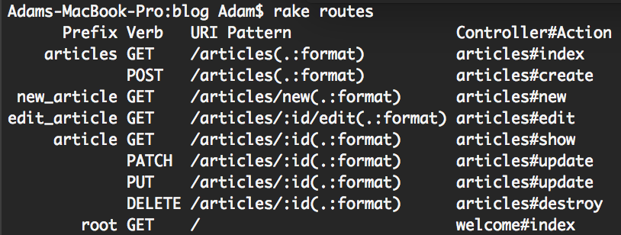
Rails routing – config/routes.rb
Rails.application.routes.draw do
resources :articles
root 'welcome#index'
end
Akcia/metoda
controller

Slide 21
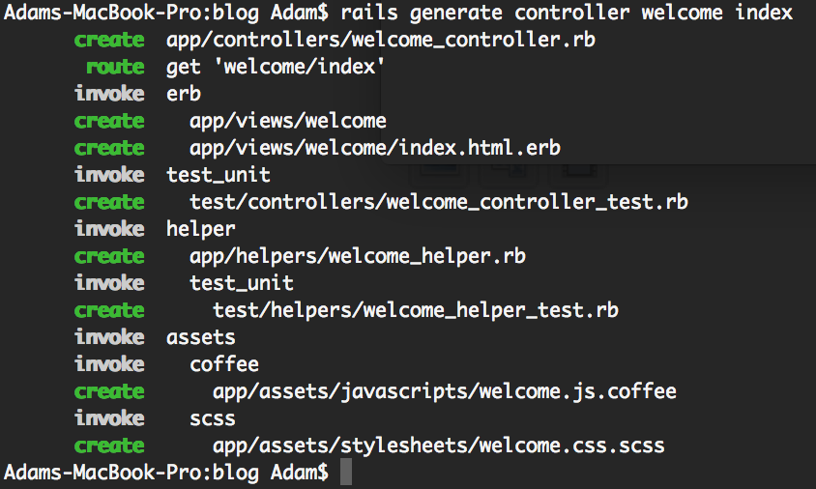
>>rails generate controller welcome index

Slide 22
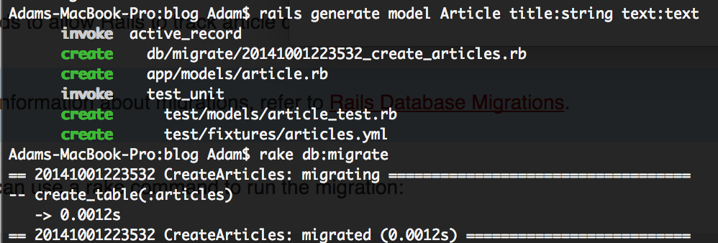
>>rails generate model Article title:string text:text
DB konfig – config/database.yml

Slide 23
generate scaffold HighScore game:string score:integer
invoke active_record
create db/migrate/20130717151933_create_high_scores.rb
create app/models/high_score.rb
invoke test_unit
create test/models/high_score_test.rb
create test/fixtures/high_scores.yml
invoke resource_route
route resources :high_scores
invoke scaffold_controller
create app/controllers/high_scores_controller.rb
invoke erb
create app/views/high_scores
create app/views/high_scores/index.html.erb
create app/views/high_scores/edit.html.erb
create app/views/high_scores/show.html.erb
create app/views/high_scores/new.html.erb
create app/views/high_scores/_form.html.erb
invoke test_unit
create test/controllers/high_scores_controller_test.rb
invoke helper
create app/helpers/high_scores_helper.rb
invoke test_unit
create test/helpers/…………………………..

